Slide 1
Lists and Mutability

Slide 2
Lists “Contain” Objects
How a list is printed
How a list is stored
Object Space
[ , ]
[ 5, 7 ]
list
5
7
int
int
Notes:
At this point, you know that a list is a container for other objects.
If you think about a physical container, like a box, you put objects inside the box. So you might also imagine that a list has other objects inside of it.
But that analogy is misleading.
Let’s see an example of a list. First, I’m going to show you what the list looks like when you print it. It looks like the 5 and 7 are inside the list.
But what is actually happening in memory? here’s the object space, and there are three different objects. There’s a list, and the 5 and the 7 are separate objects of type int. When we say that the list contains the 5 and the 7, that really means that the list has a references to them. A reference is a pointer to the correct memory location. This is similar to the way that a variable points to a specific object.
How does python print this list?
It’s step by step. First, print the bracket, then go to the first index and follow the reference.
Whatever object you get to, print it. In this case, you print the five.
Then go back up to the list, and to the next index. follow that reference and print the object you get to.
Then go back up to the list, and you see we’re at the end. So what do you do, you print the closing bracket.

Slide 3
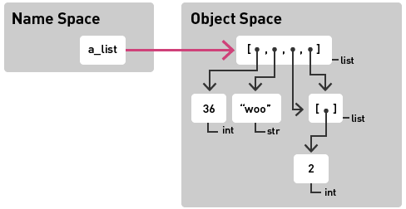
Lists “Contain” Objects (cont.)
What would print(a_list) display?
Notes:
Here’s a more complicated example. you can see a list that contains some different types of objects, an int, a string, and even another list.
What would this look like if you printed it?

Slide 4
Things to Remember
Objects can be reached in multiple ways.
Mutating an object affects all variables with paths to that object.
Notes:
e depicting with arrows.

Slide 5
Example 1
Name Space
Object Space
a_list
[ , ]
list
b_list
5
7
int
int
Notes:
Here’s one example. We have two names, but they point to the same list. What would happen if we changed this list in some way?
Let’s say we set changed index 1 to be a 9.
Then the thing to realize is that if you print a_list or if you print b_list, you’ll get [5,9], because both names point to the same object.

Slide 6
Example 2
Name Space
Object Space
a_list
[ ]
list
b_list
[ ]
list
[ ]
list
Notes:
Here’s another example. a_list and b_list point to different lists.
But what about this list in the middle. You can see that it’s inside a_list. There’s a path from a list to here.
it’s also inside b_list.
So what if you change this list, let’s add an element to it.
Now you can see that both a_list and b_list have changed.
If you’re not expecting this, it’s easy to make a mistake.

Slide 7
Lists and Mutability

